Slide 1
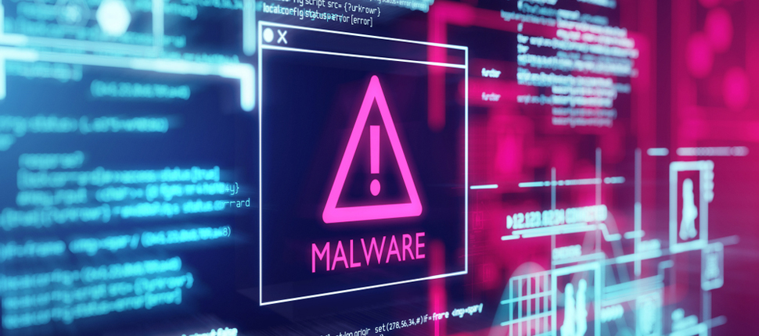
SP PROJECT

Slide 2
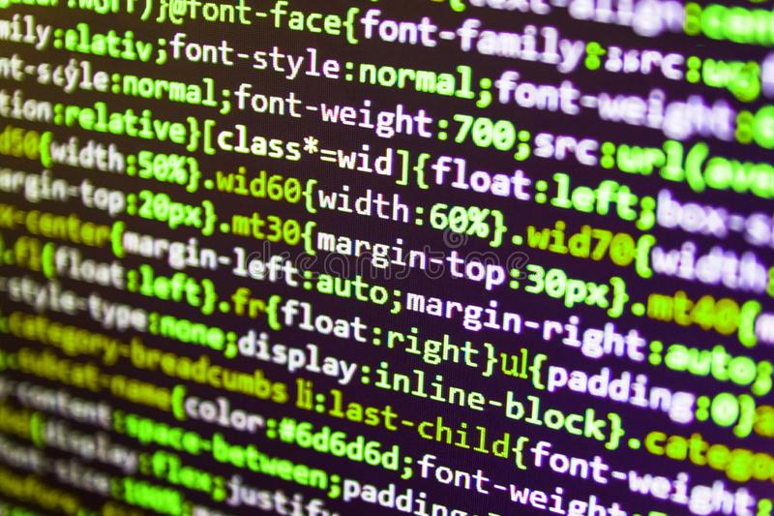
MALSMART
Team:-
ACHINTYA VATSRAJ(1941101)
KAUSHIK(1941116)
KEERTHAN GOWDA M(1941117)
VIJETHA SHRAVYA(1941166)
By:
Achintya Vatsraj(1941101 )
Kaushik( 1941116 )
Keerthan Gowda M(1941117 )
Vijetha Shravya(1941166 )
Guided by : Ummesalma M
Under the guidance of Ummesalma M

Slide 3
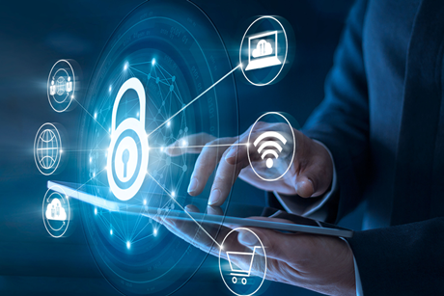
Our Domain:- Client Side Cyber Security

Slide 4
Introduction:
Computers are an important part of everyday life to many people across the world. Computers in the hands of consumers who lack the knowledge of protection tools and who have limited administrator skills are vulnerable to virus attacks.A recent trend in attacks has been the attempt to disable security protocols in place at the host machine. This type of attack leaves the host computer completely defenseless and vulnerable to many further exploits through the Internet. To ensure the continuous functioning of the security protocols, a software-based solution is proposed in this thesis.AI and machine learning antivirus leverage sophisticated mathematical algorithms combined with the data from other deployments to understand what the baseline of security is for a given system.

Slide 5
Objective:-
To generate a new, effective framework to analyse the behavioural characteristics of the malware family and the mechanics of its operation.
To develop a malware detection Toolkit, consisting of a simple structural prototype built from open source software, Implement scanning and content discovery functionality using Python.
To conduct an extensive literature review of the different trials associated with malware detection and to identify the parameters for developing the most efficient tools for a live system
Develop an ecosystem of Apps across platforms to provide concrete client side security(such as Desktop GUI(tkinter),Mobile App,Chrome Extension.)

Slide 6
SYSTEM ANALYSIS:-
The Existing Client Side Security solutions do feature one or the other type of detection and Prevention techniques but they do not for the most part try to mix and match the said methods, and no product on the market has both an extension and mobile application to go with their desktop security solution.
Our Project is using the SQL Database Architecture to store data in relational models.

Slide 7
Components of the Project:
Desktop Application
Backend System
AI/ML Model
Chrome Extension
Mobile APP(NOT YET IMPLEMENTED)

Slide 8
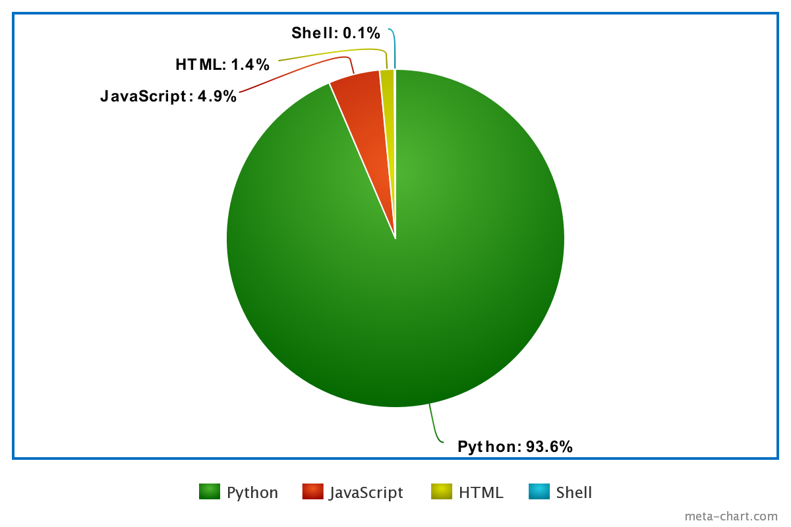
Languages of the Project:

Slide 9
PROFILE OF THE PROBLEM
If you are using a free antivirus program, there is no guarantee that it will provide you the complete protection. Most free antivirus programs out there only offer a basic level of protection. Moreover they are capable of identifying only certain types of threats. In order for acquiring complete level of protection, you have to use a firewall as well.Using an antivirus program means that a lot of resources from the memory and the hard drive is being used. As a result it can drastically slow down overall speed of the computer. Moreover, the process of scanning can also cause lags in the network.

Slide 10
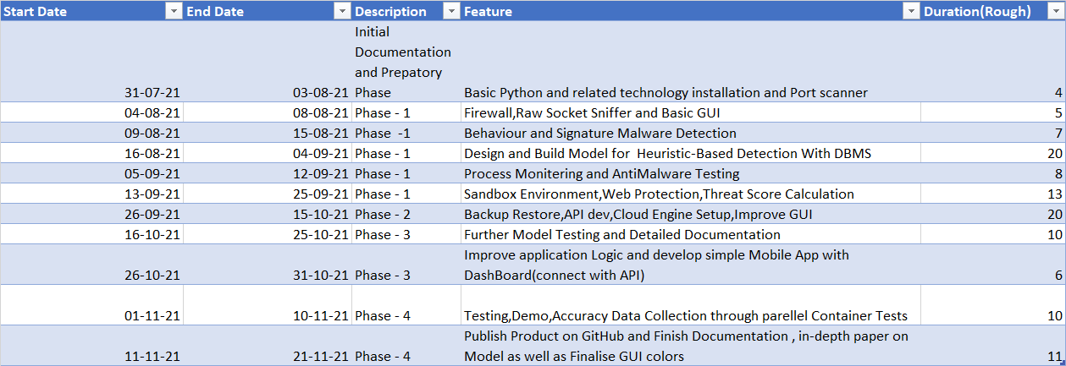
Gantt chart

Slide 11
SOFTWARE REQUIREMENTS
At Developer Side
Software Used
●HTML
●VISUAL STUDIO CODE
●PYTHON
●SQLITE3 DATABASE
●JAVASCRIPT
●C / Assembly
At System Users Side
Software Requirements
●Browser (IE 7.0 or Above, Mozilla Firefox, Google Chrome
●Browser Must be JavaScript Enabled

Slide 12
HARDWARE REQUIREMENTS
At Developer Side
Hardware Used
●Intel core i5
●Atleast 16 GB RAM.
●O.S. – Windows 10 or *Nix
At System Users Side
Hardware Requirements
●Intel Core i3
●O.S. – Windows 10 or *Nix

Slide 13
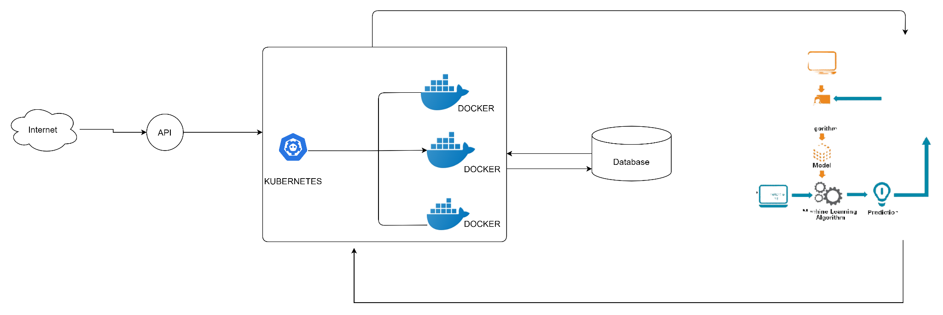
Block diagram:-

Slide 14
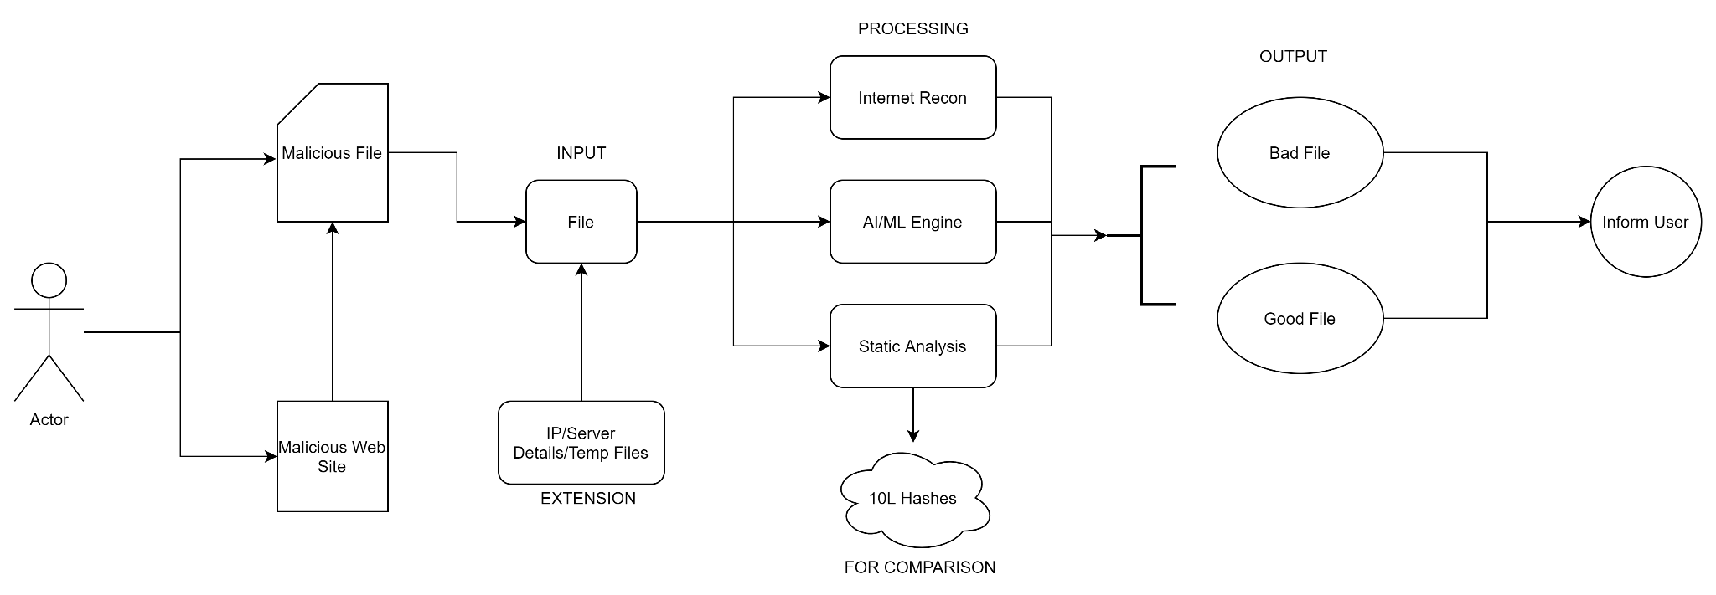
Data Flow Diagram

Slide 15
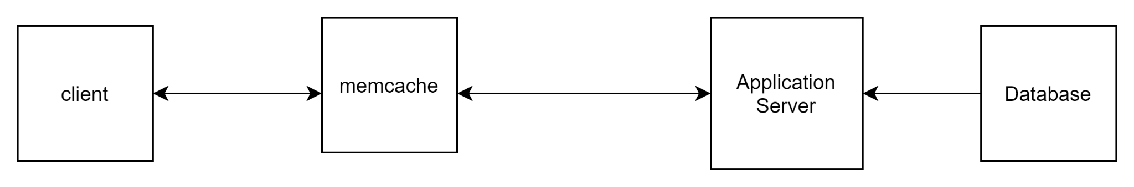
4 tier architecture

Slide 16
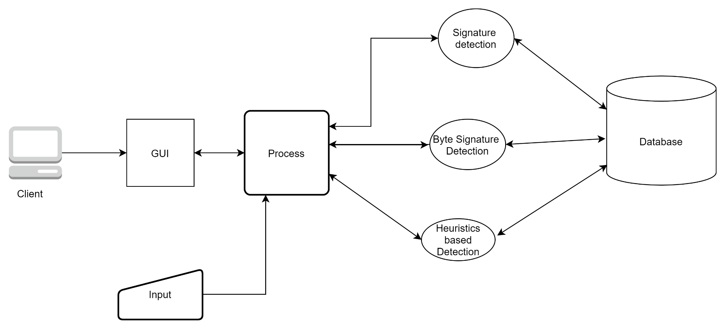
malware detection cycle

Slide 17
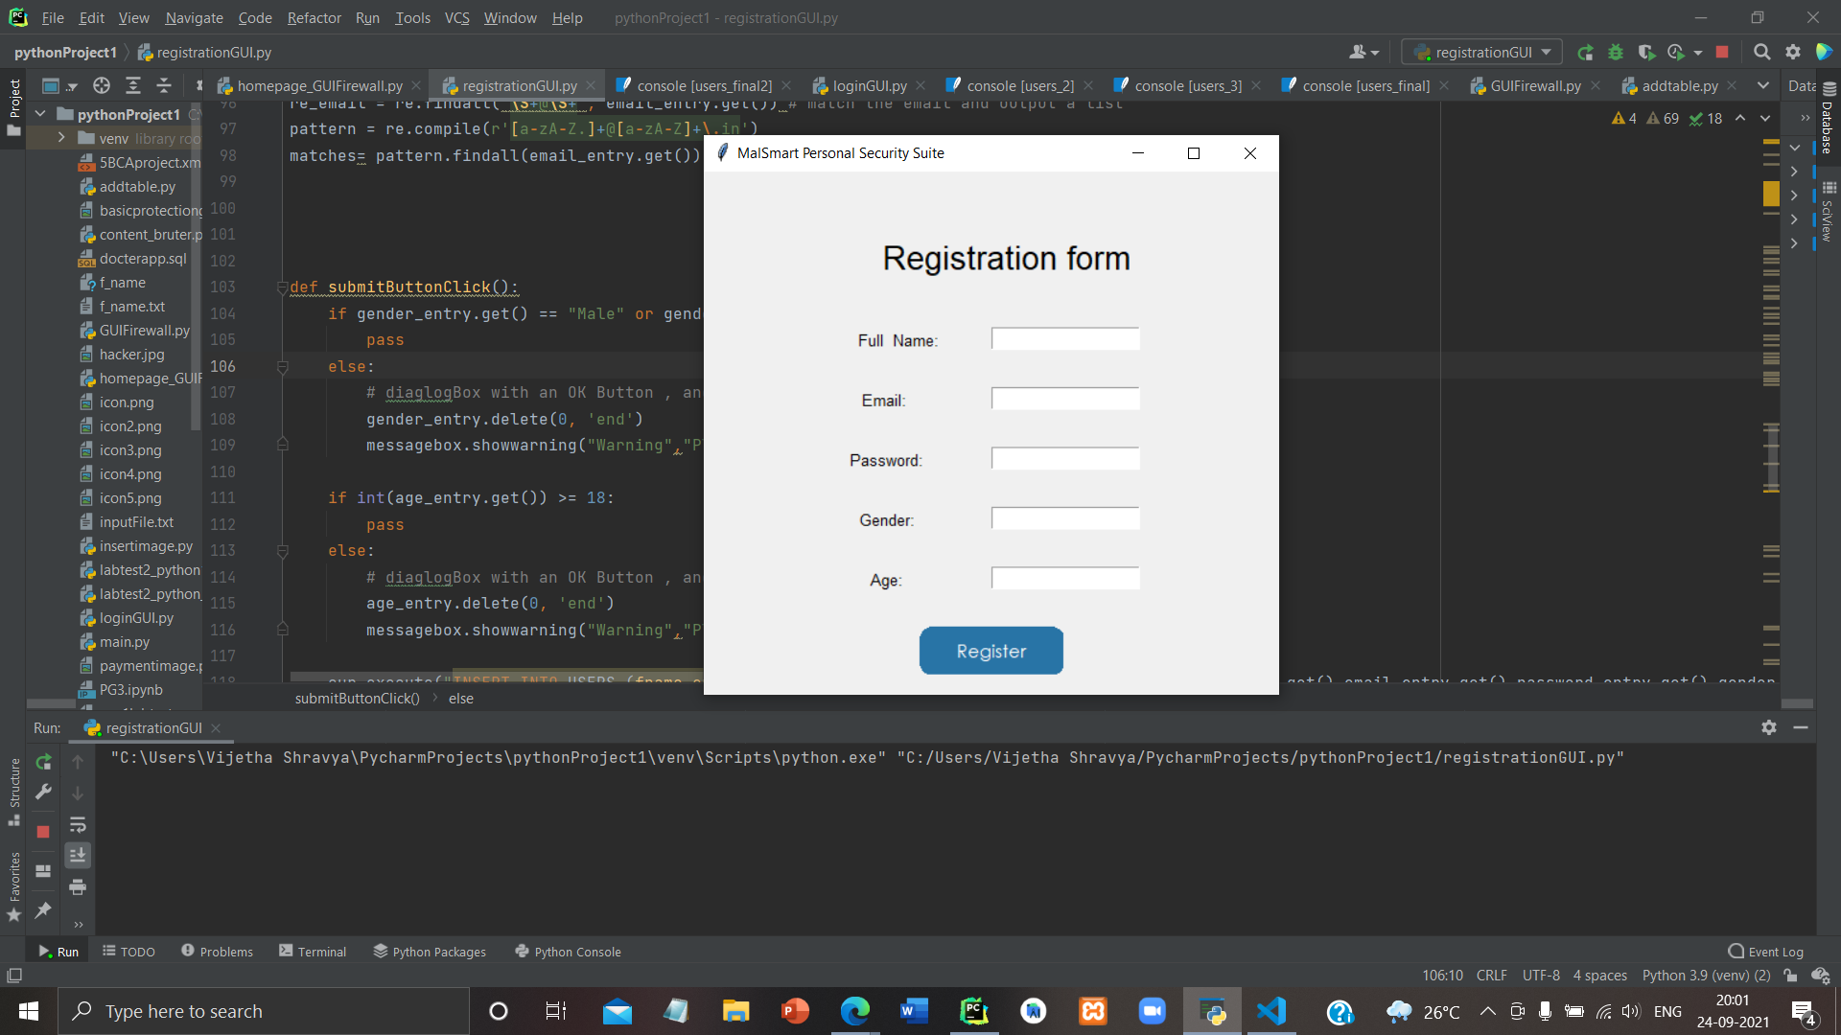
GUI using python tkinter
Screenshot 1:

Slide 18
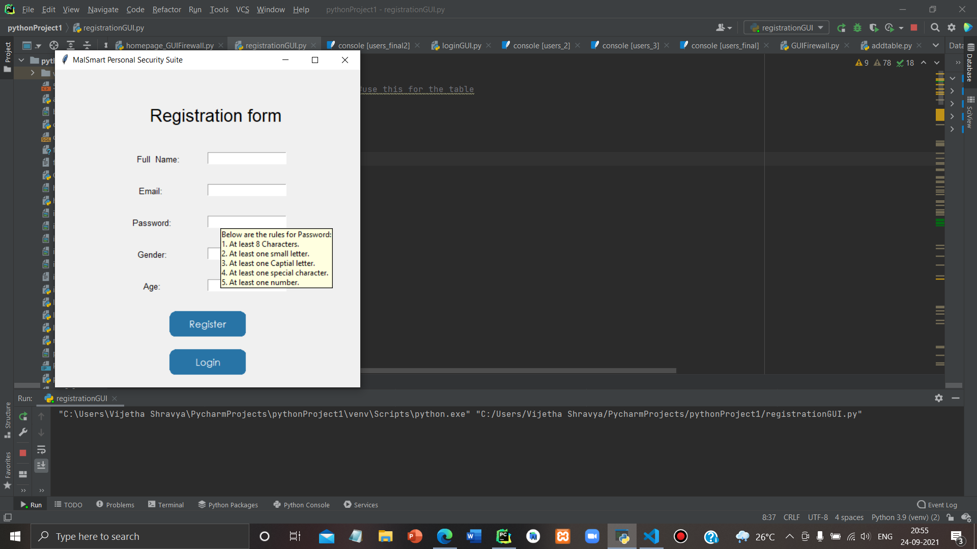
Screenshot 2:

Slide 19
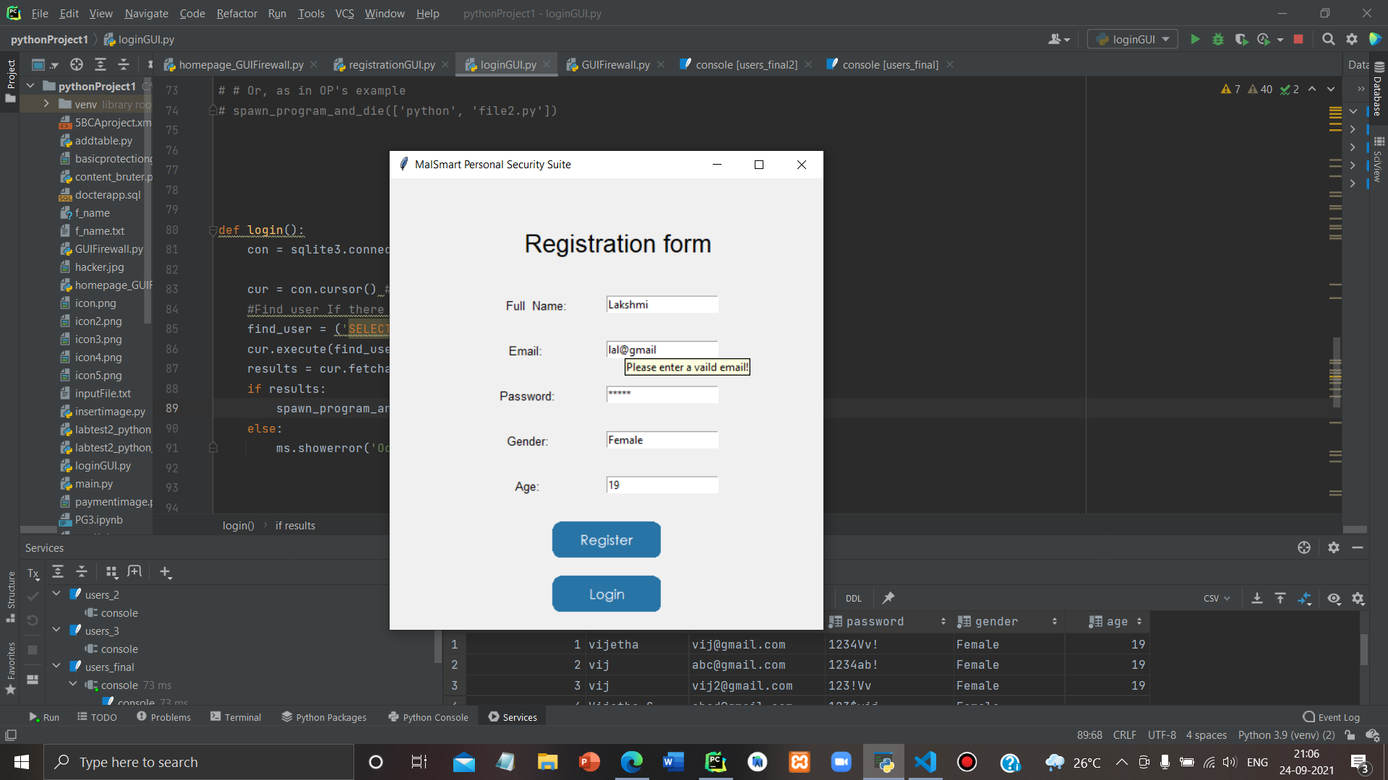
Screenshot 3:

Slide 20
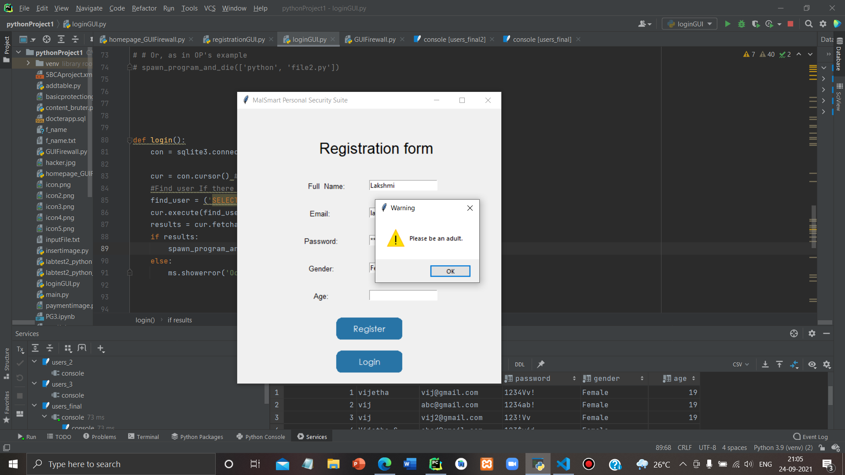
Screenshot 4:

Slide 21
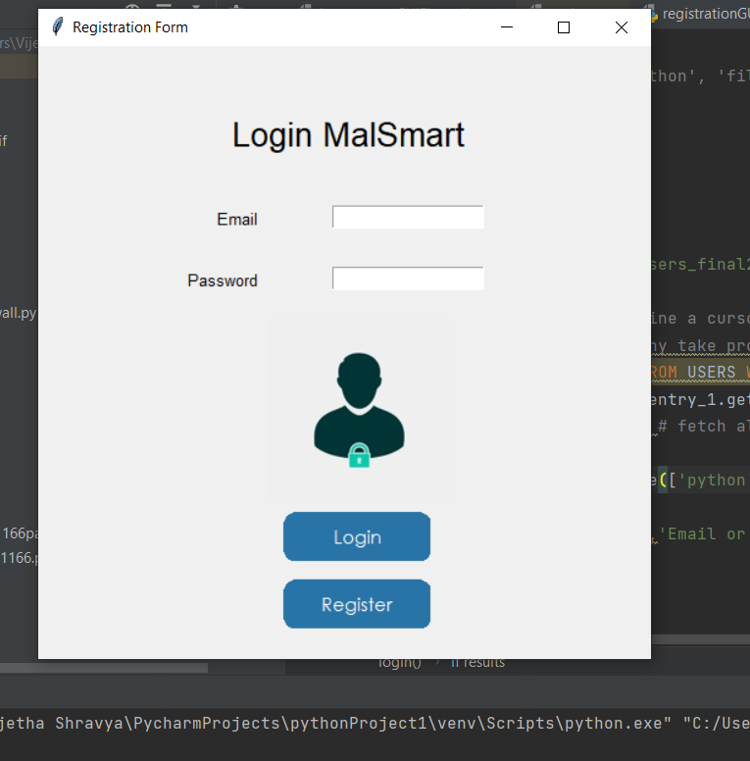
Screenshot :

Slide 22
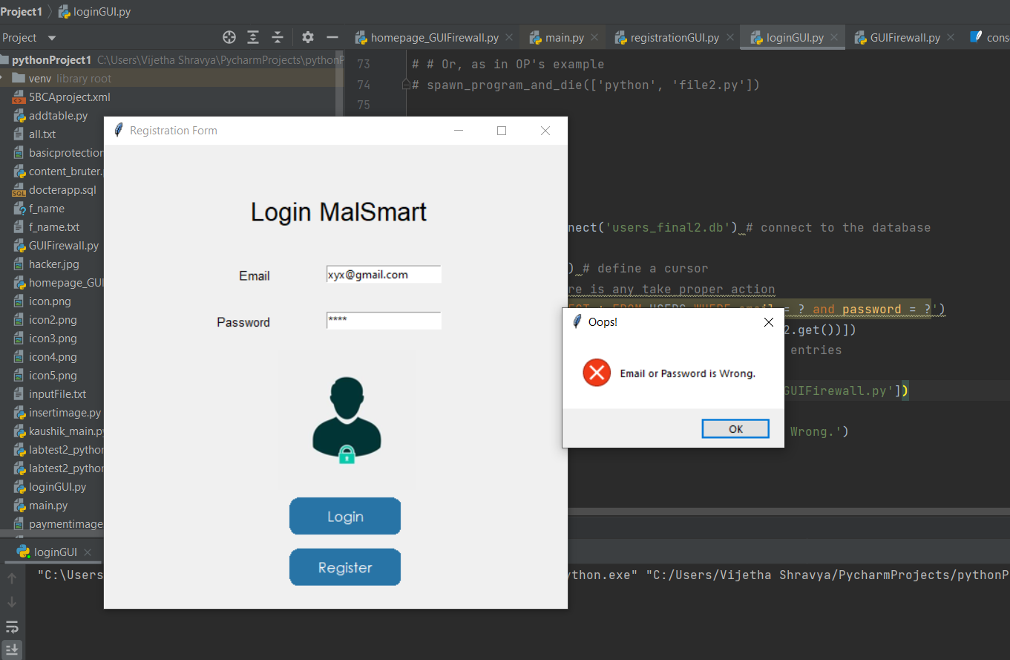
Screenshot :

Slide 23
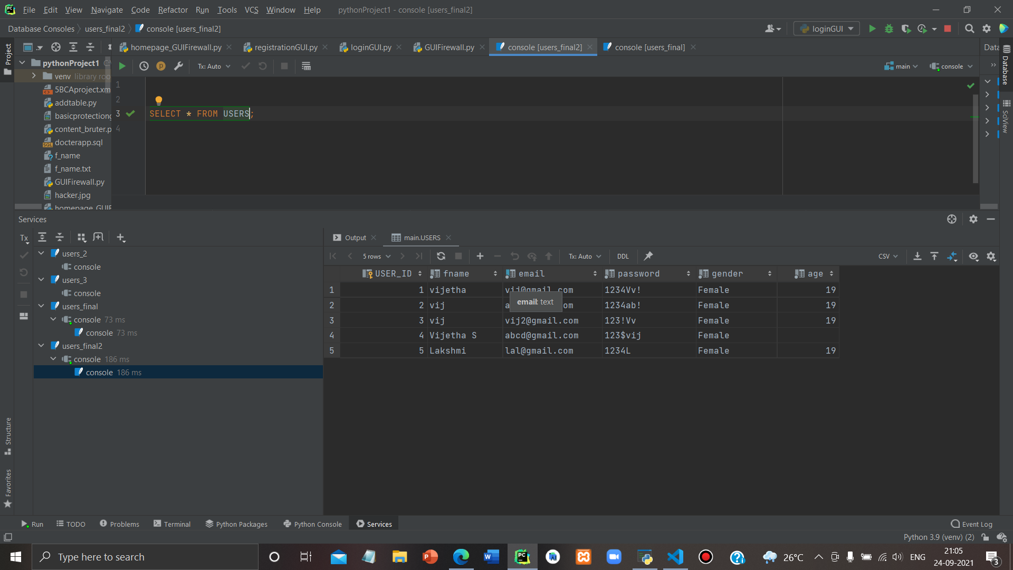
Screenshot 5:

Slide 24
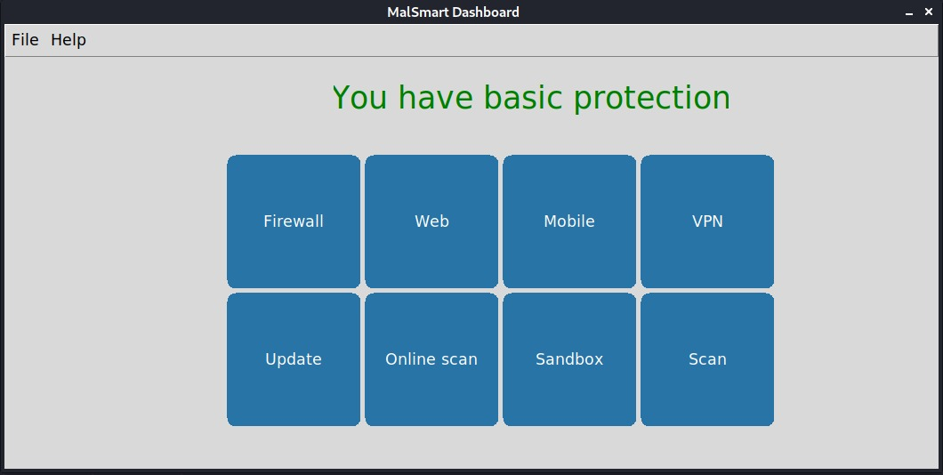
Screenshot 6:

Slide 25
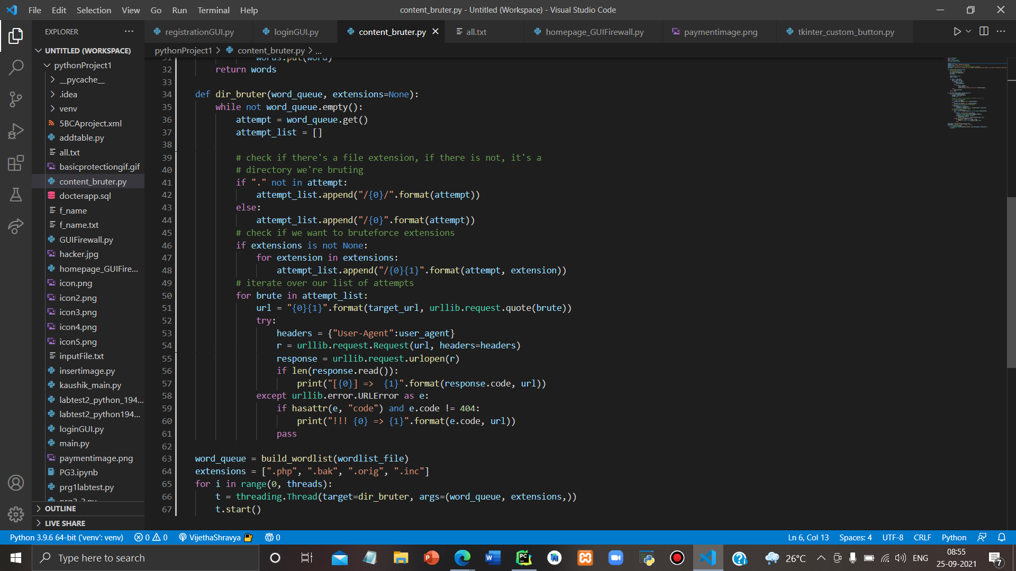
Screenshot :

Slide 26
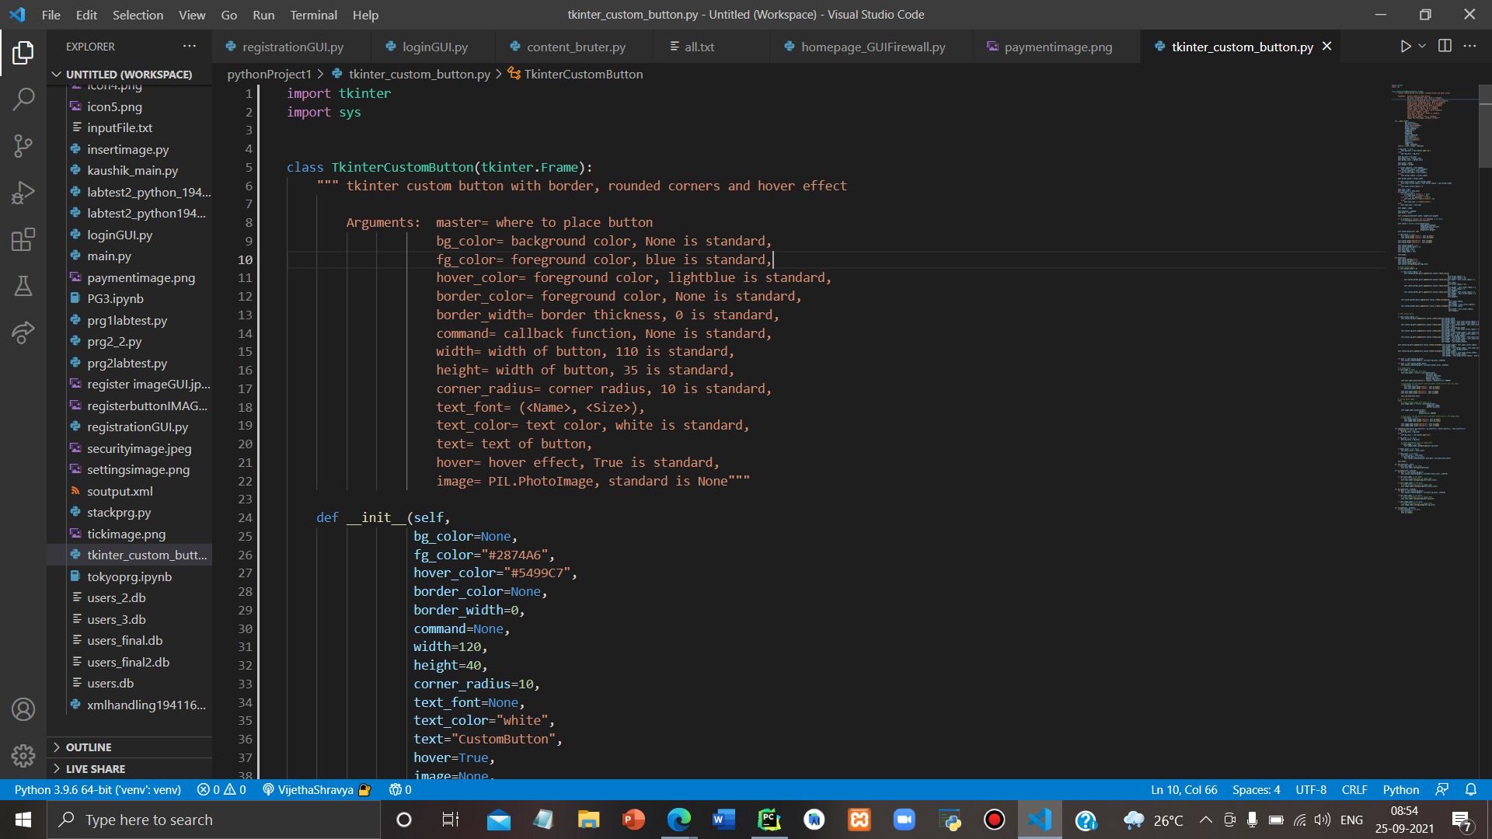
Screenshot :

Slide 27
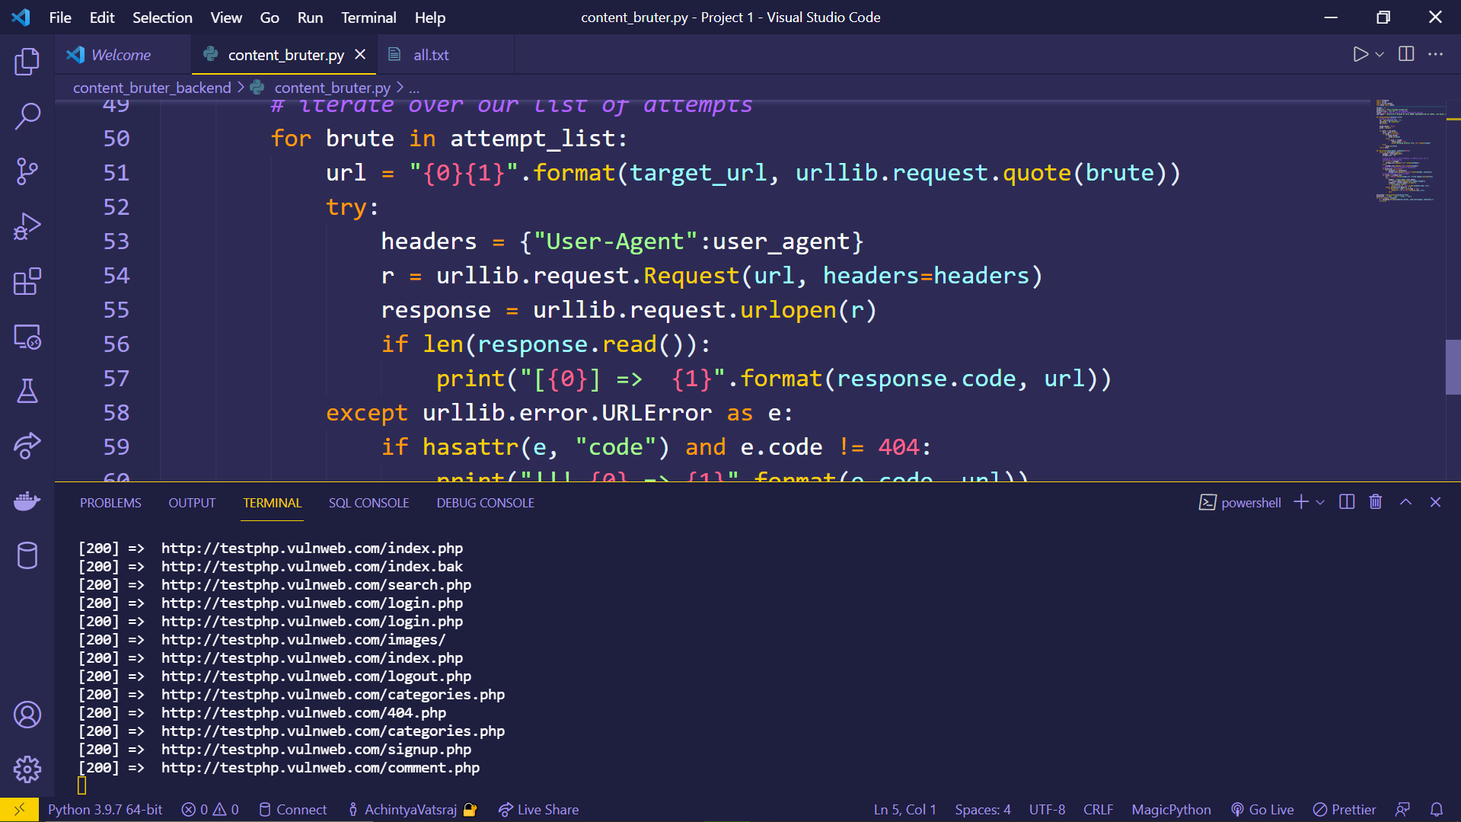
Screenshot :

Slide 28
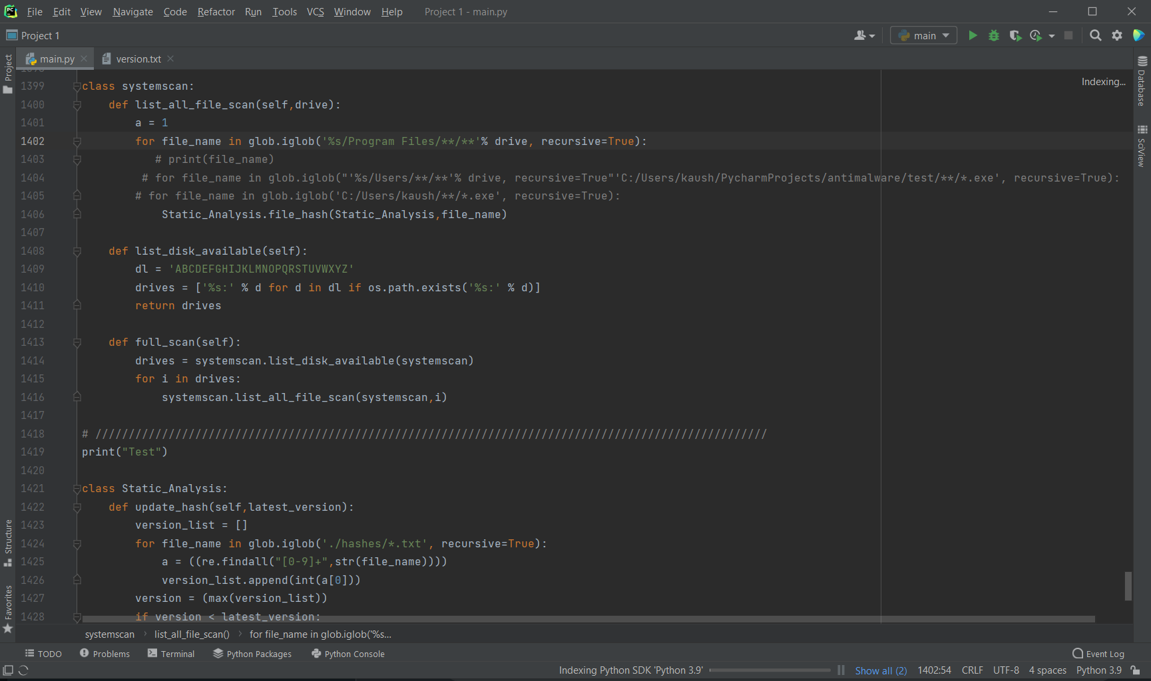
Screenshot :

Slide 29
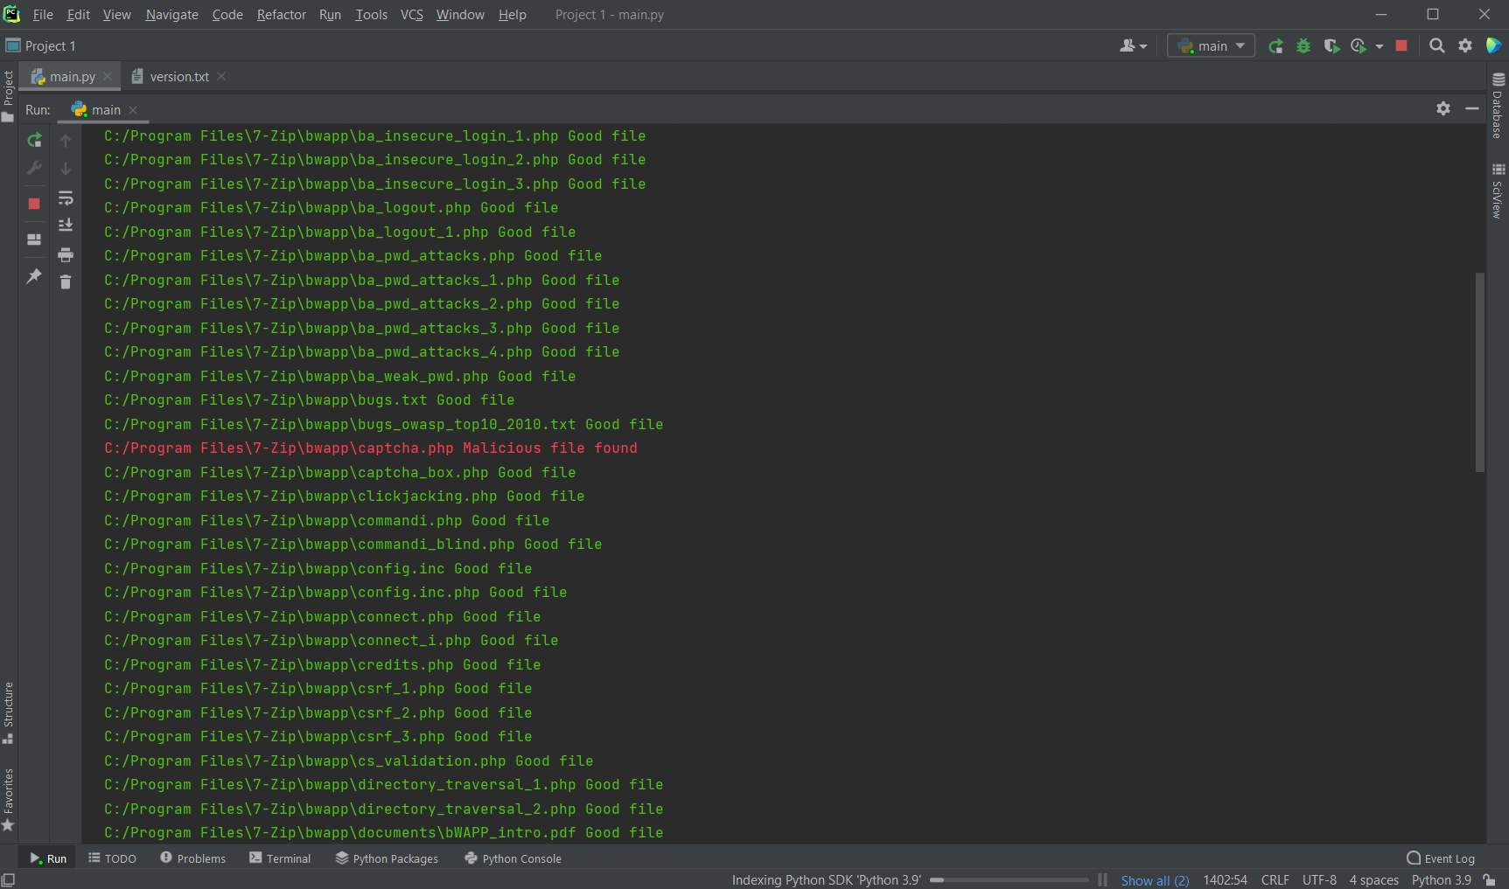
Screenshot :

Slide 30
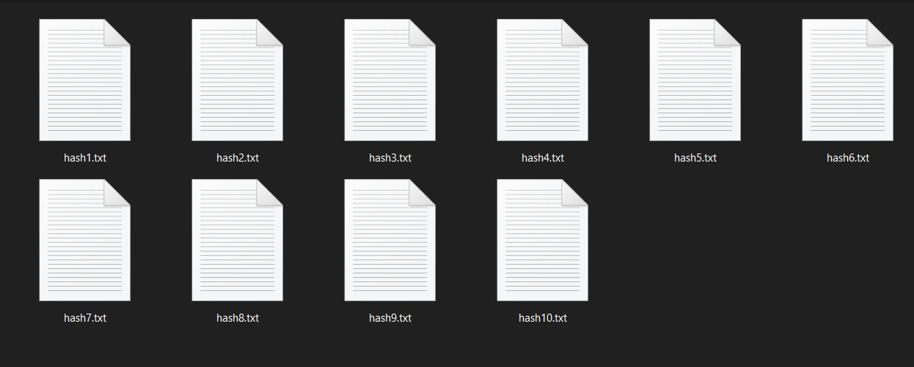
Screenshot :

Slide 31
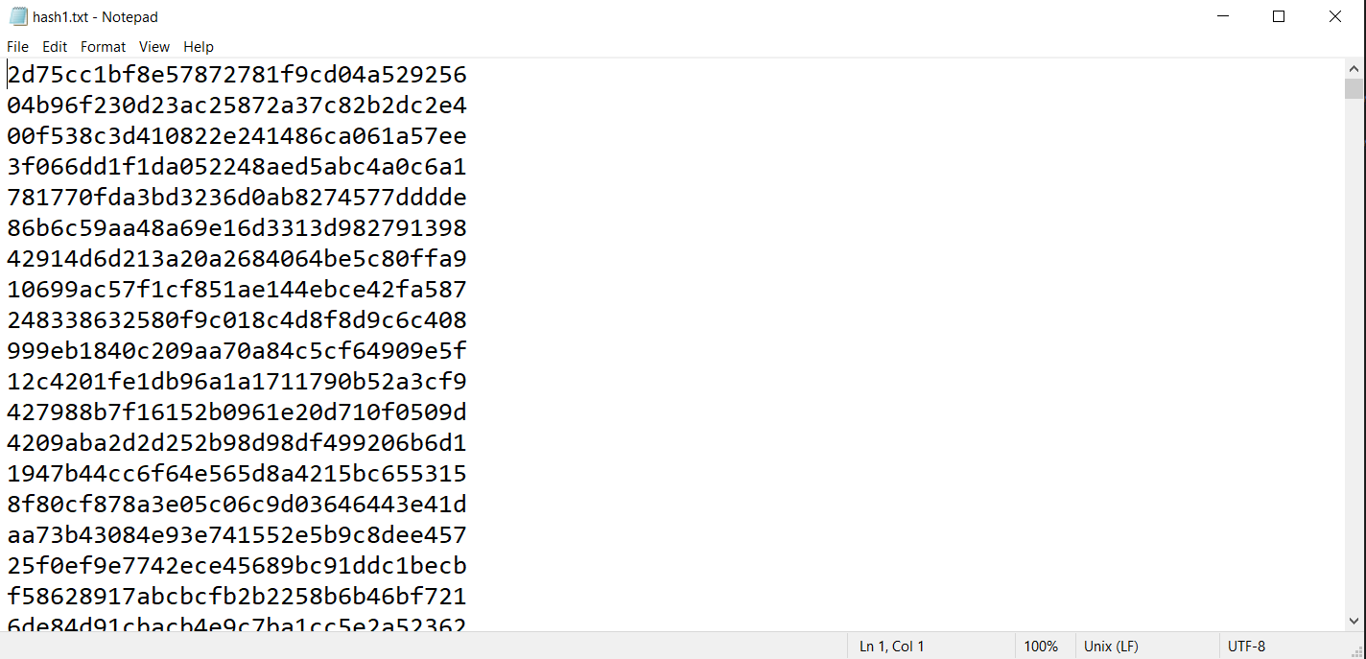
Screenshot :

Slide 32

Interesting Fact about Analysis
We have 10L+ Hashes to do comparison that we will regularly improve/update to get better results and accuracy in Analysis.

Slide 33
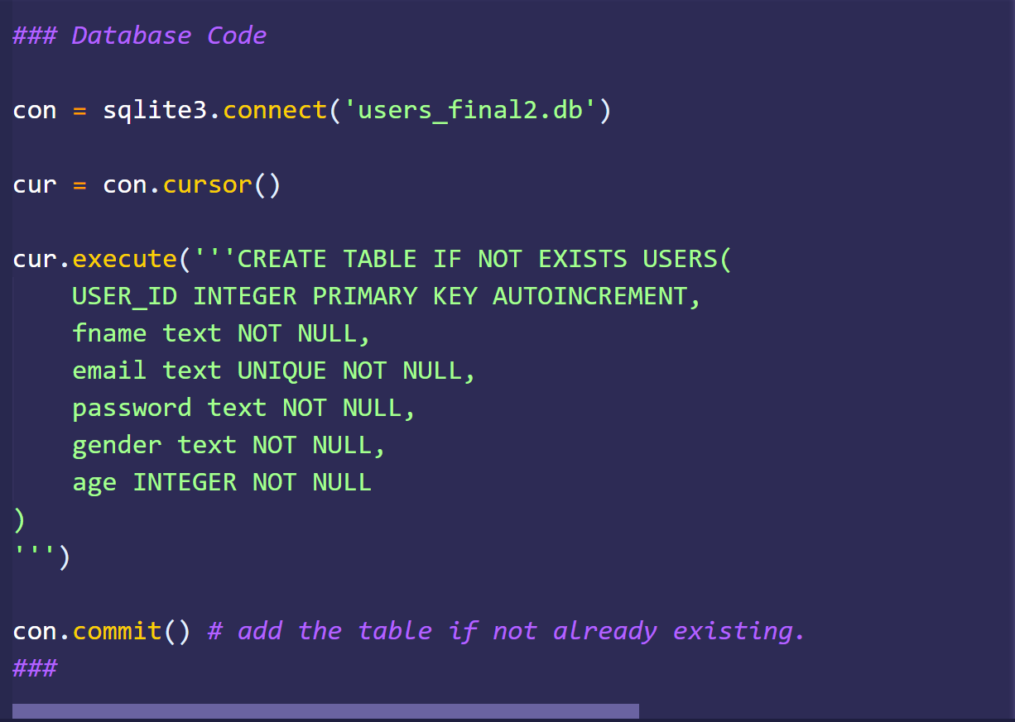
Screenshot of Database Creation:

Slide 34
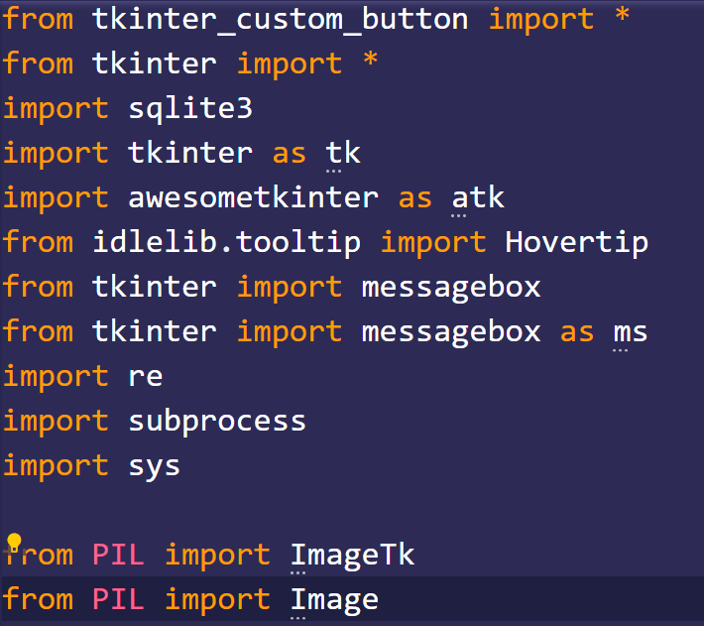
Screenshot of Imports for the Project:

Slide 35
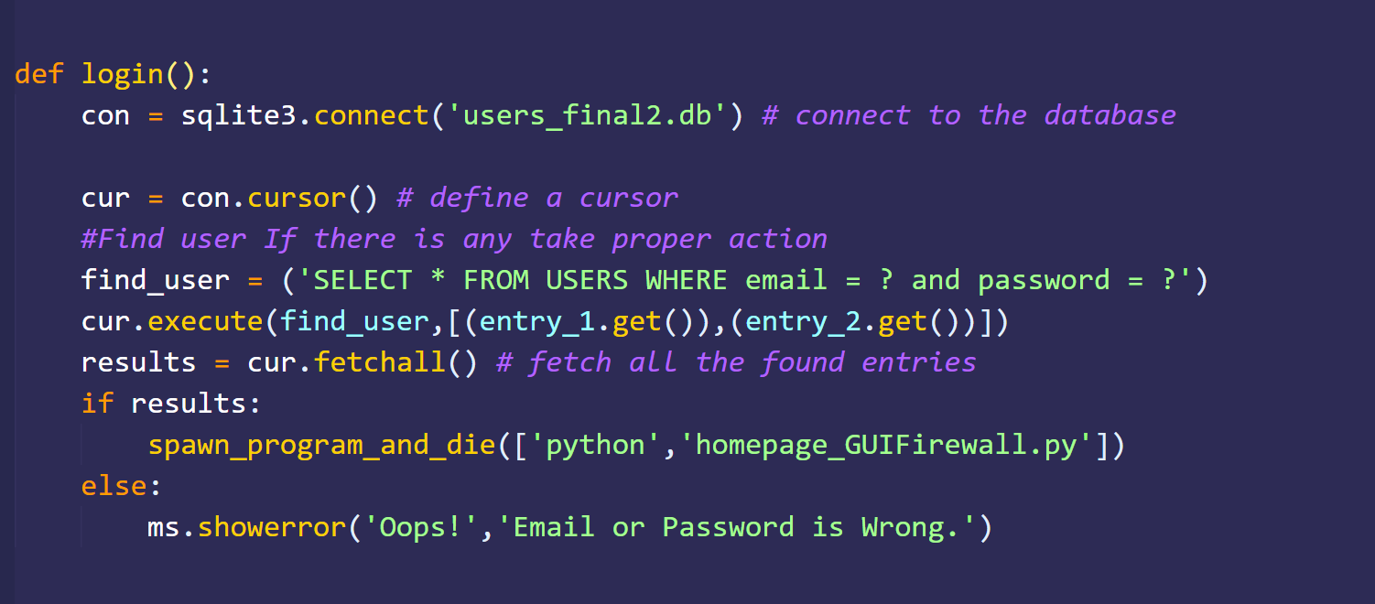
Screenshots:

Slide 36
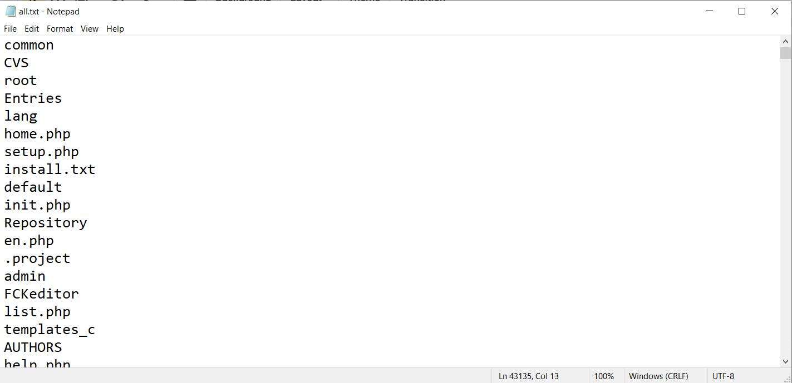
Screenshots for Content/Folder BruteForcing:

Slide 37
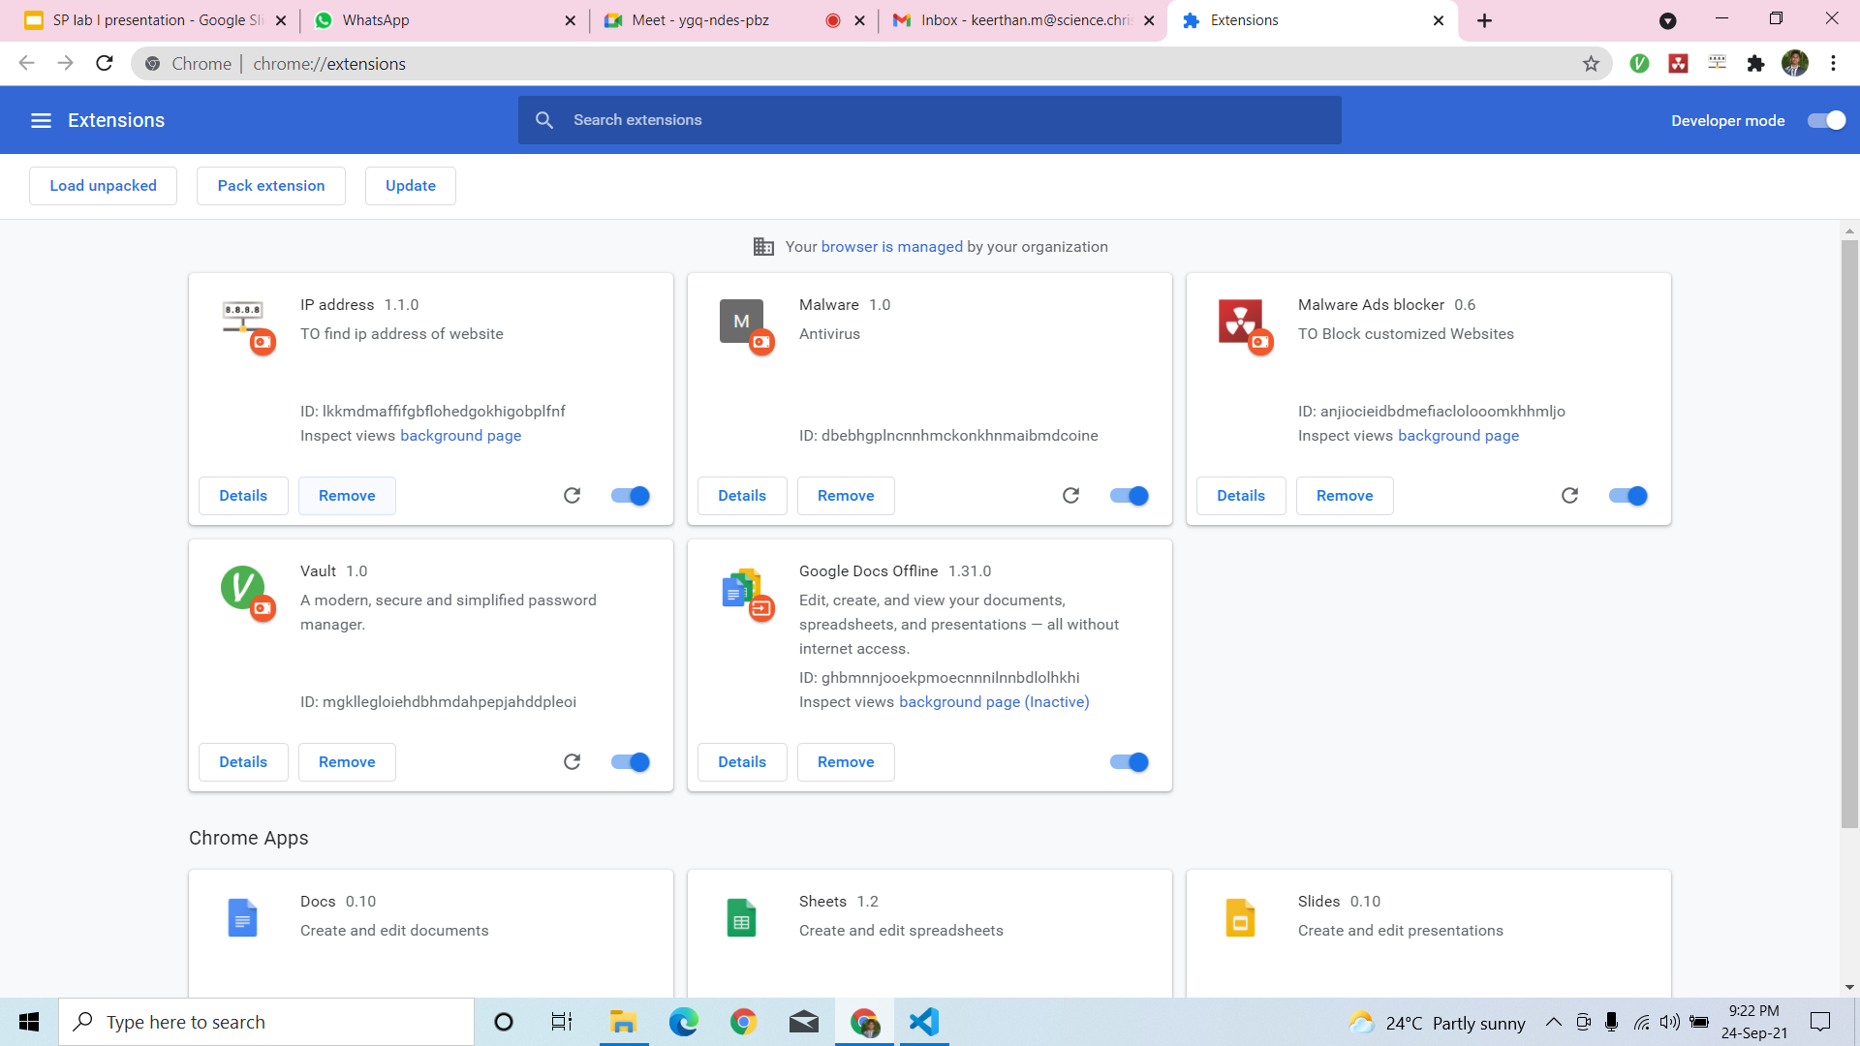
Chrome extension screenshots
Screenshot 1:

Slide 38
Screenshot 2:

Slide 39
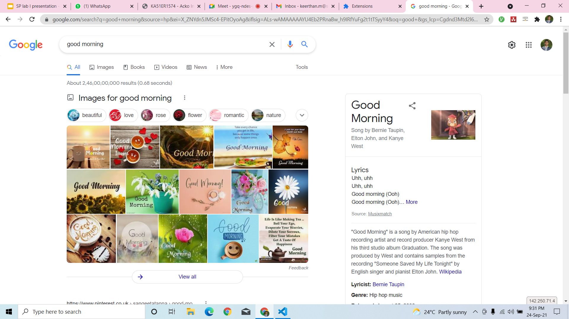
Screenshot 3:

Slide 40
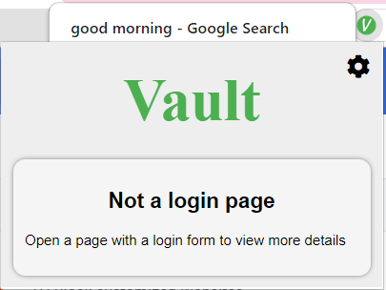
Screenshot 4:

Slide 41
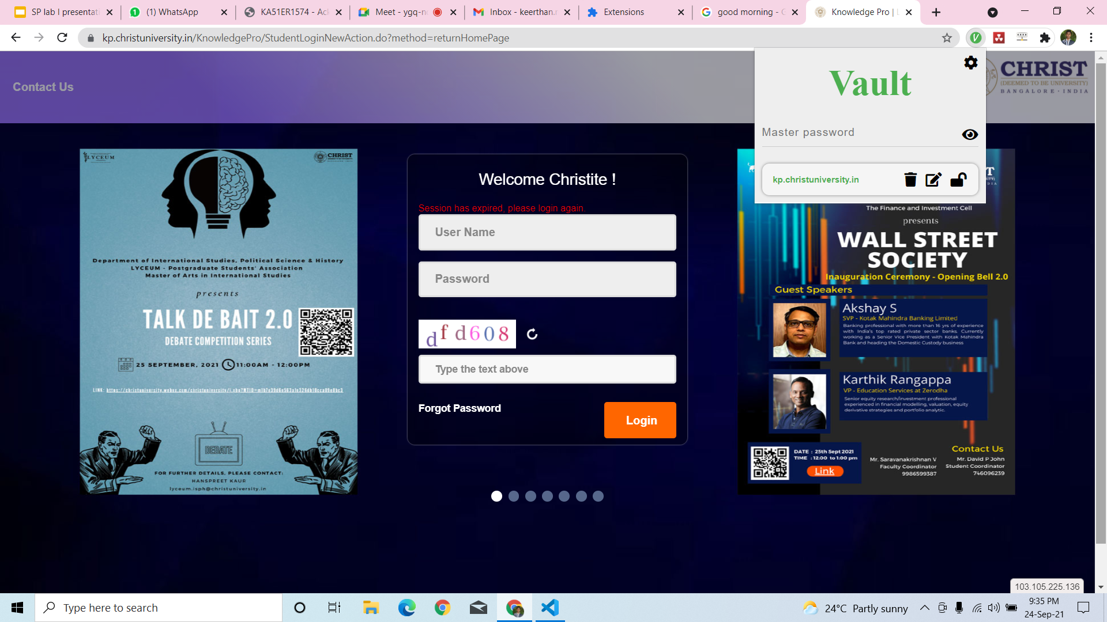
Screenshot 5:

Slide 42
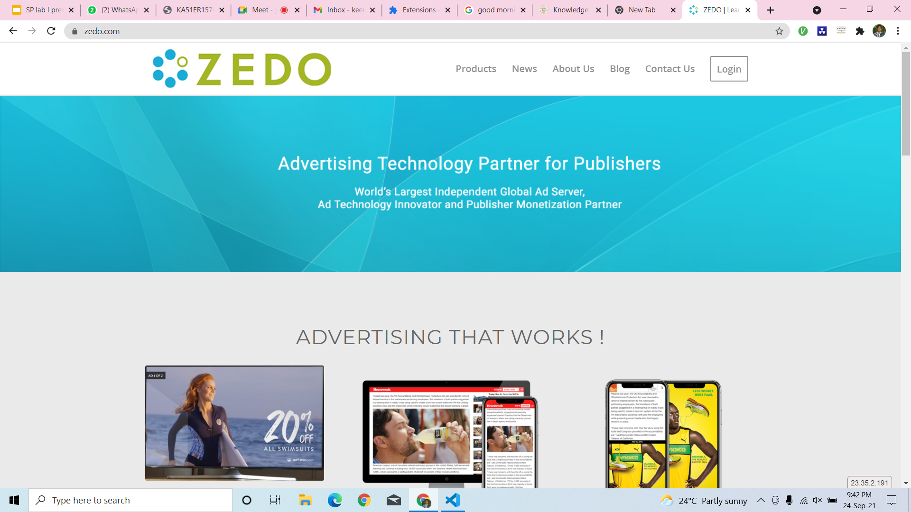
Screenshot 7:

Slide 43
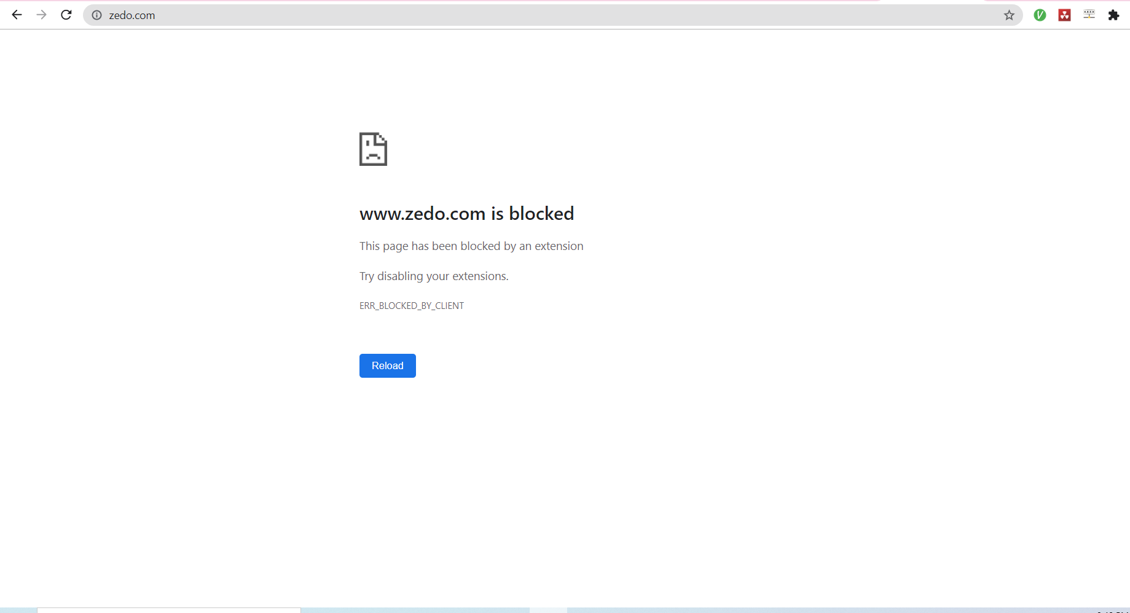
Screenshot 6:

Slide 44
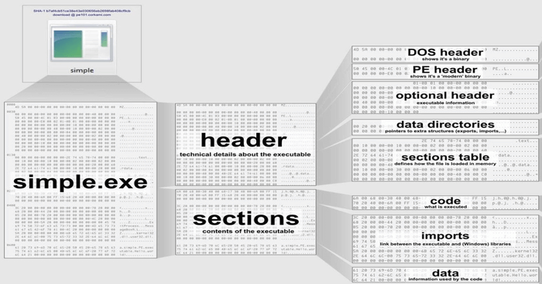

Slide 45
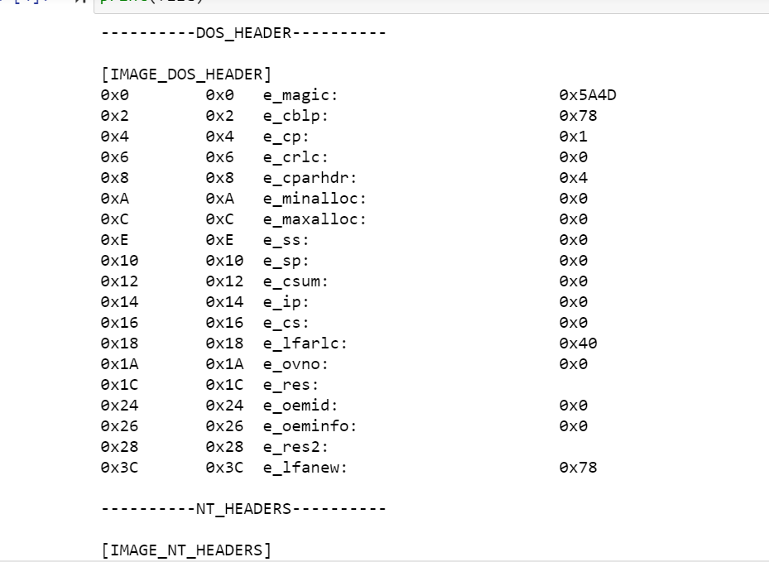

Slide 46
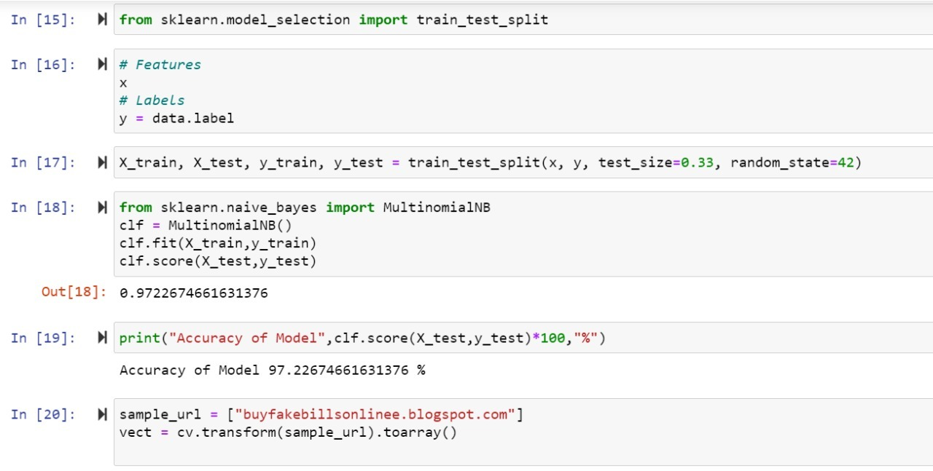

Slide 47
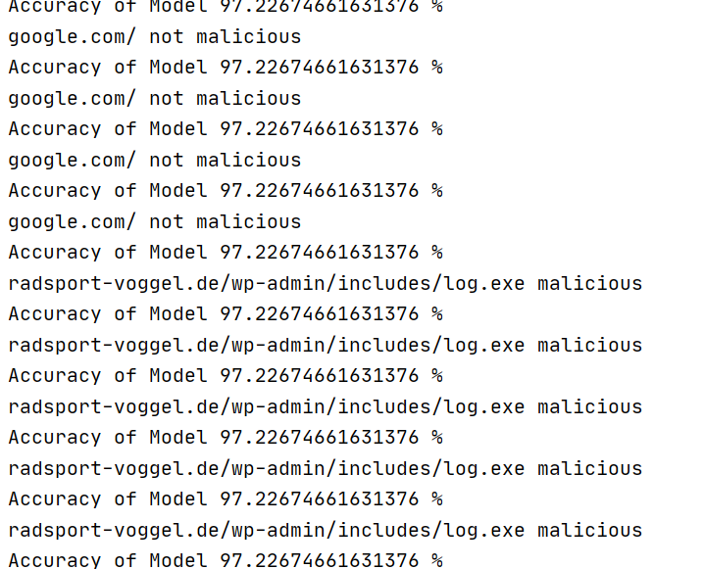

Slide 48
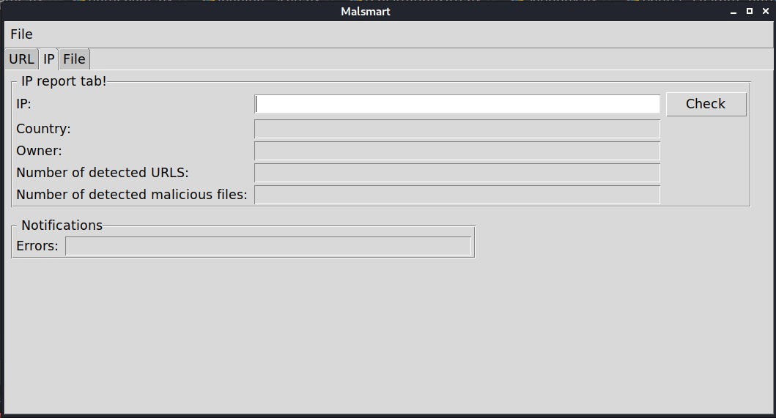
Screenshot 7:

Slide 49
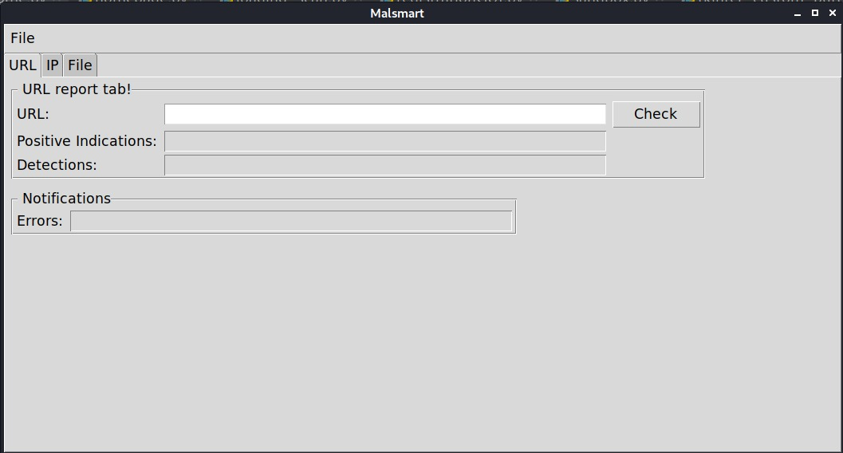
Screenshot 8:

Slide 50
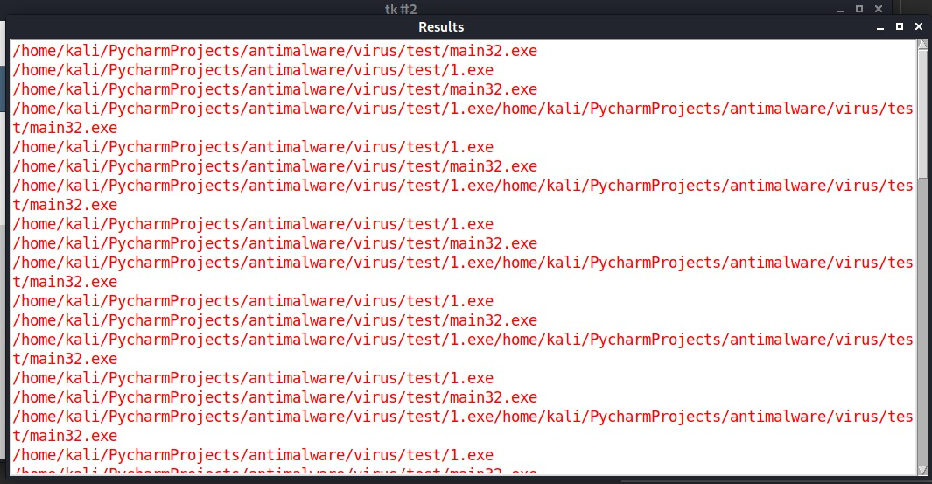
Screenshot 9:

Slide 51
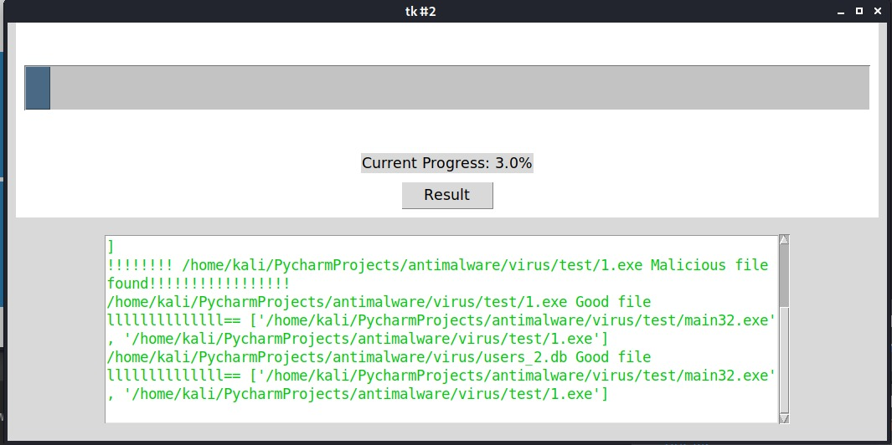
Screenshot 10:

Slide 52
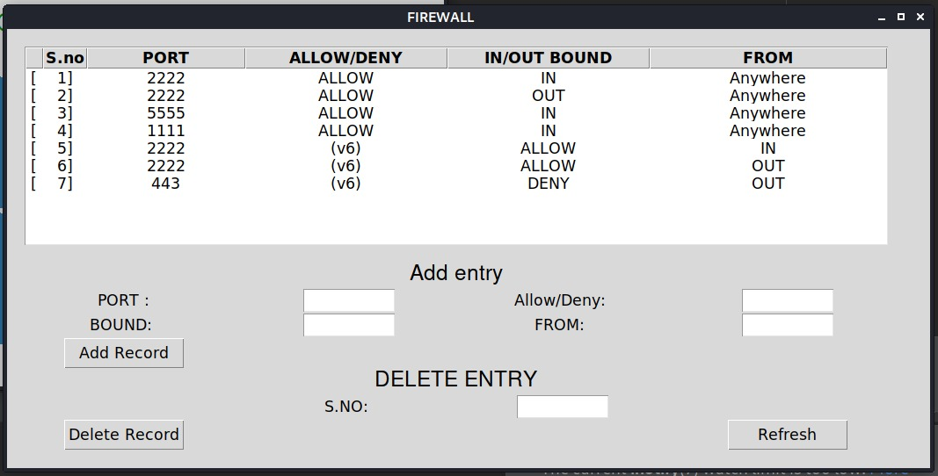
Screenshot 11:

Slide 53
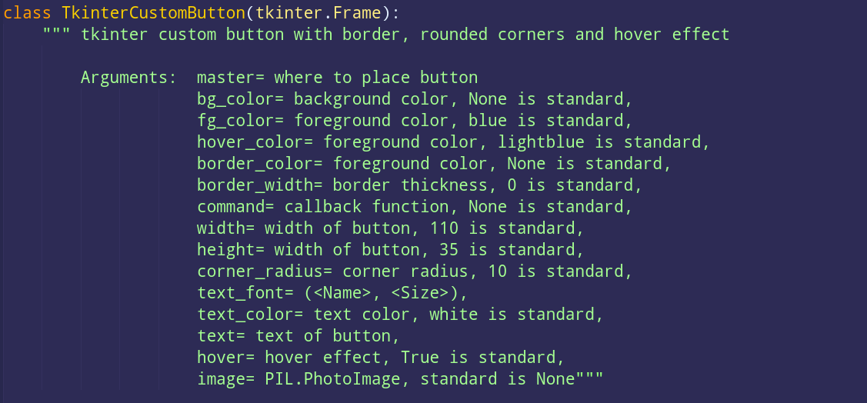
Screenshot 12:

Slide 54
Screenshot 13:

Slide 55
Github LInk
https://github.com/AchintyaVatsraj/MalSmart

Slide 56


Slide 57


